Slide 1
Chapter 5: Homeostasis controls blood glucose and body temperature

Slide 2
5.1 Homeostasis
Homeostasis is the process of keeping the environment inside the body fairly constant (steady state). The body’s cells are surrounded by fluid, the composition and temperature of which must be maintained within very narrow limits. The important aspects of the internal environment that the body needs to regulate include:
• core body temperature
• pH and concentrations of dissolved substances in the body fluids
• concentration of glucose in the blood
• concentration of oxygen and carbon dioxide in the blood & other body fluids
• blood pressure
• concentration of metabolic wastes.
To maintain homeostasis, the body must be able to both sense changes in the internal and external environment and compensate for those changes. The nervous and endocrine systems are the main sensory and controlling body systems; in the case of homeostasis, they operate through feedback systems, many of which involve negative feedback.

Slide 3
5.1 Homeostasis
Feedback systems
A feedback system is a circular situation in which the body responds to a change, or stimulus, with the response altering the original stimulus and thus providing feedback. Feedback systems can be negative or positive, depending on whether the response decreases or increases the original stimulus.
Feedback systems have a number of common features.
• The stimulus is the change in the environment that causes the system to operate.
• The receptor detects the change.
• The modulator is a control centre responsible for processing information received from the receptor and for sending information to the effector.
• The effector carries out a response counteracting or enhancing the effect of the stimulus.
• Feedback is achieved because the original stimulus has been changed by the response.

Slide 4
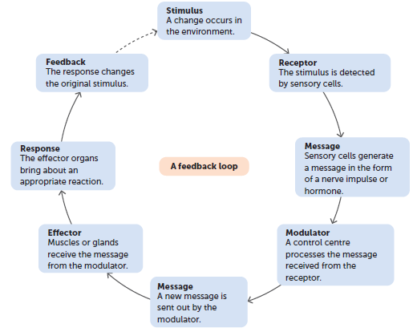
5.1 Homeostasis
The stimulus–response–feedback model is a simple way of explaining how homeostatic mechanisms work.

Slide 5
5.1 Homeostasis
Negative feedback
In homeostatic mechanisms the response has the effect of reducing or eliminating the stimulus that caused it, called negative feedback. Negative feedback systems are also called steady state control systems, as they return the body to a steady state.
An analogy that is often used to explain a negative feedback loop is that of an air-conditioning system in a room or building. The next slide shows how the components of the air-conditioning system correspond to the components of a negative feedback loop. Note that the temperature fluctuates above and below the temperature set on the thermostat. It is the same with the human body. Things such as the concentration of blood glucose and body temperature fluctuate around a normal level, called a dynamic equilibrium. The point around which conditions fluctuate is called the set point. Tolerance limits are the upper and lower limits between which the levels fluctuate. Within these limits the body functions normally; however, a rise above, or a fall below, them means that the individual’s tolerance limits have been exceeded and dysfunctions will occur.

Slide 6
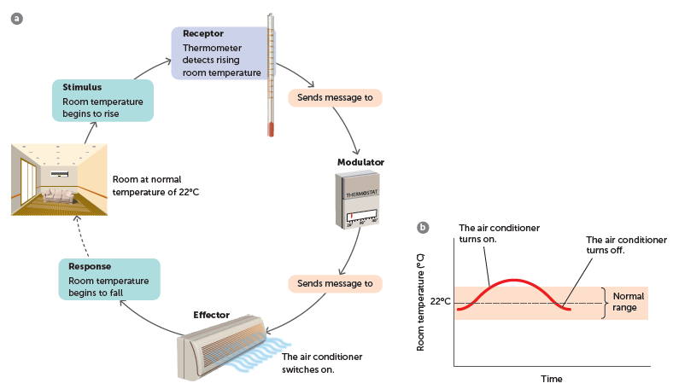
5.1 Homeostasis
a An air-conditioning system uses negative feedback to keep the room temperature fairly constant. b Room temperature fluctuates around the temperature determined by the thermostat

Slide 7
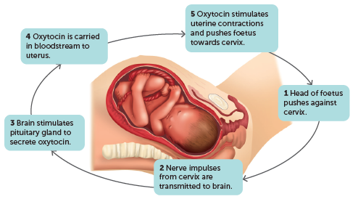
5.1 Homeostasis
Positive feedback
Positive feedback has no role in homeostasis. When positive feedback occurs, the response to a stimulus reinforces and intensifies the stimulus. The intensified stimulus results in an even greater response, and so on. This could not result in homeostasis, but there are a few situations in which it does occur in the human body where it is important in controlling processes that must be completed quickly. An example is during childbirth.

Slide 8
5.2 Regulation of blood sugar
Sugar in the blood is in the form of glucose. All cells need a constant supply of glucose because it is the source of energy for all the cells’ activities, such as movement, reproduction, synthesising molecules and active transport. Energy is released from glucose molecules by cellular respiration.
Glucose + oxygen → carbon dioxide + water + energy
The body’s source of glucose is the food we eat. Carbohydrates in our food are broken down into glucose during digestion and then absorbed into the blood through the walls of the small intestine. After a meal, blood glucose concentration can rise sharply. Homeostatic mechanisms then begin to operate to reduce the blood glucose concentration and maintain it at the normal level. Any excess glucose in the blood must be removed and stored ready for use in cellular activities between meals.

Slide 9
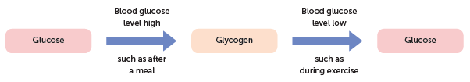
5.2 Regulation of blood sugar
Glucose and glycogen
Glucose is stored as glycogen, a molecule made of long chains of glucose molecules. The body is able to store about 500 g of glycogen: about 100 g is stored in the liver and the remainder in skeletal muscle cells. Excess glucose in the is converted to glycogen for storage. Alternatively, when there is not enough glucose in the blood, some of the glycogen can be converted to glucose.
Summary of glucose–glycogen conversions

Slide 10
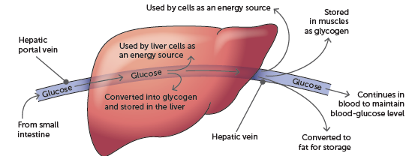
5.2 Regulation of blood sugar
Role of the liver
The liver is the largest gland in the body and has a very important role in the control of blood sugar concentration. The liver is able to convert glucose into glycogen for storage, or glycogen to glucose for release into the blood.
Most of the liver’s blood supply comes through the hepatic portal vein, which brings blood directly from the stomach, spleen, pancreas, and small and large intestines. The liver has the first chance to absorb the nutrients from digested food.
After a typical meal containing a high proportion of carbohydrates is consumed, the breakdown products, mainly glucose, are absorbed into the blood capillaries of the villi of the small intestine. The hepatic portal vein carries the glucose to the liver, where a number of things may occur.

Slide 11
5.2 Regulation of blood sugar
Glucose molecules are chemically joined in long chains to form glycogen molecules. This process, glycogenesis, is stimulated by the pancreatic hormone insulin. Glycogen itself cannot be used by cells; it must be converted back into glucose or to other simple sugars.
Glycogen stored in the liver is available for conversion into glucose to maintain blood sugar levels and supply energy for liver activity. Glycogen in muscle cells provides the glucose required for muscle activity.
If the level of glucose in the blood drops below normal, the glycogen stored in the liver and muscle cells can be broken down into glucose, a process called glycogenolysis. Most frequently, it occurs between meals and is stimulated by another pancreatic hormone, glucagon.
Glycogen stored in the liver is a short-term energy supply. It can provide glucose for body cell use for only about six hours if no other supply is available. If more energy is required, the body uses the energy reserves in stored fat.

Slide 12
5.2 Regulation of blood sugar
Role of the pancreas
The pancreas is 12–15 cm long and lies partly in the curve of the duodenum. Within the pancreas are clusters of hormone-secreting cells called the islets of Langerhans. The cells in the islets are of two types:
• alpha cells that secrete glucagon
• beta cells that secrete insulin.
Insulin from the beta cells causes a decrease in blood glucose levels. The level of blood glucose regulates the secretion of insulin via a negative feedback system.
When blood glucose levels rise above normal, chemoreceptors in the beta cells of the islets of Langerhans stimulate those cells to secrete insulin. As the level of blood glucose decreases, the cells are no longer stimulated and production is reduced.

Slide 13
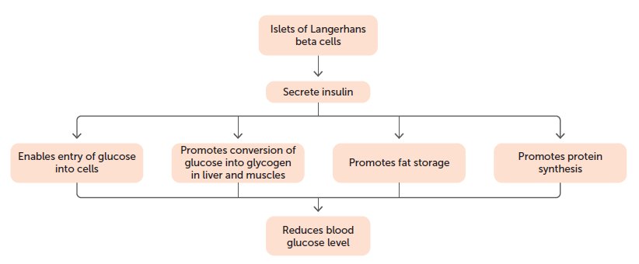
5.2 Regulation of blood sugar
Effects of insulin on blood glucose levels

Slide 14
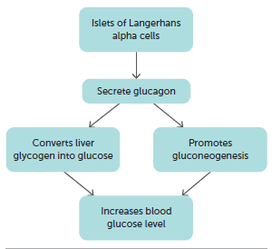
5.2 Regulation of blood sugar
Glucagon from the alpha cells causes an increase in blood glucose levels.
The glucose formed is released into the blood, and the blood glucose level rises.
The regulation of the secretion of glucagon, like that of insulin secretion, is directly determined by the level of glucose in the blood and is controlled by a negative feedback system. When the blood glucose falls below normal, chemoreceptors in the alpha cells of the islets of Langerhans stimulate those cells to secrete glucagon. As the blood glucose level increases, the cells are no longer stimulated and production is reduced.
Effects of glucagon on blood glucose levels

Slide 15
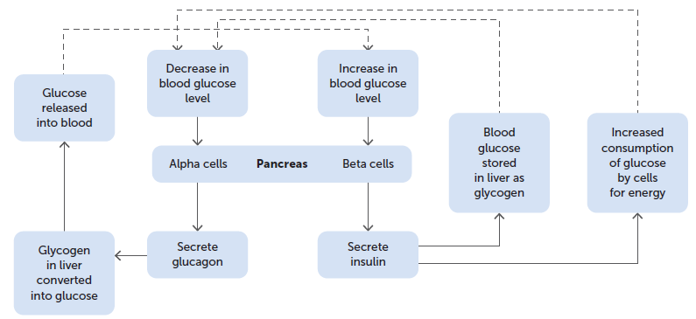
5.2 Regulation of blood sugar
Regulation of blood glucose by insulin and glucagon

Slide 16
5.2 Regulation of blood sugar
Role of the adrenal glands
The adrenal glands are situated just above the kidneys, one gland above each. Each gland is composed of two distinct parts: the outer part is called the cortex and the inner part is the medulla.
The adrenal cortex is stimulated to secrete its hormones by adrenocorticotropic hormone (ACTH) from the anterior lobe of the pituitary gland. The hormones secreted are glucocorticoids, including cortisol. They regulate carbohydrate metabolism by ensuring that enough energy is provided to the cells. In doing so, they stimulate the conversion of glycogen into glucose during glycogenolysis. They also increase the rate at which amino acids are removed from cells, mainly muscle cells, and transported to the liver. Some of these amino acids may be converted into glucose by the liver during gluconeogenesis if glycogen and fat levels are low.
Glucocorticoids also promote the mobilisation of fatty acids from adipose tissue, allowing muscle cells to shift from using glucose to fatty acids for much of their metabolic energy.

Slide 17
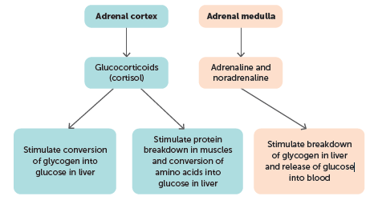
5.2 Regulation of blood sugar
The adrenal medulla synthesises adrenaline and noradrenaline, hormones that produce the same effects as those brought about by sympathetic nerves of the autonomic nervous system.
One such effect is the increase of blood glucose levels. In particular, adrenaline elevates blood glucose levels through glycogenolysis and in doing so counteracts the effects of insulin. It stimulates the production of lactic acid from glycogen in muscle cells, which can then be used by the liver to manufacture glucose.
Effect of adrenal hormones on blood glucose levels

Slide 18
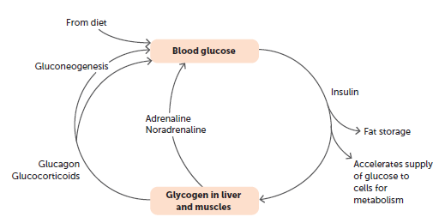
5.2 Regulation of blood sugar
Blood glucose homeostasis
The normal level of glucose in the blood is between 4 and 6 millimoles per litre. Homeostasis relies on the contribution of the liver, pancreas and adrenal glands, working in an integrated manner.
Summary of blood glucose homeostasis

Slide 19
5.3 Thermoregulation
Thermoregulation involves the regulation of body temperature to keep the body’s core temperature within its tolerance limits.
Heat gain and heat loss
The body temperature of humans remains constant at about 36.8°C. This temperature of is optimum for cellular reactions, and so cells maintained at this temperature function in a stable manner. To achieve this temperature, the heat gained by the body must exactly equal the heat lost from the body. Maintaining this balance is thermoregulation.
Although body temperature remains fairly constant, variation does occur as a matter, for example during strenuous activity or changes in external temperature.

Slide 20
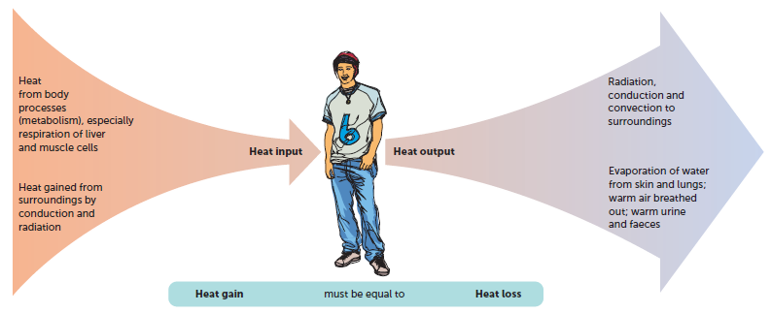
5.3 Thermoregulation
A constant human body temperature is achieved by a balance between heat gain and heat loss
Heat production
The carbohydrates, proteins and lipids that we eat contain energy, which is released when the food is oxidised during cellular respiration, mostly in the form of heat.
The rate at which energy is released by the breakdown of food is called the metabolic rate. Many factors, such as exercise, stress and body temperature, affect the metabolic rate of an individual.

Slide 21
5.3 Thermoregulation
Regulating body temperature
Temperature receptors
The body has temperature receptors, or thermoreceptors. Those in the skin and in some mucous membranes are called peripheral thermoreceptors. They detect temperature changes in the external environment and send this information to the hypothalamus. Others are located in the hypothalamus and are called central thermoreceptors. These receptors detect the temperature of the internal environment. There are additional thermoreceptors at various internal locations such as the spinal cord and the abdominal organs that provide the hypothalamus with information about the temperature of the internal environment.
There are two types of thermoreceptors: cold receptors are stimulated by temperatures lower than normal; and heat receptors detect temperatures higher than normal. When cold receptors are stimulated, the hypothalamus receives the information and initiates heat conservation and heat production mechanisms. If heat receptors are stimulated, mechanisms operate to reduce heat production and increase heat loss.

Slide 22
5.3 Thermoregulation
The skin and temperature regulation
Heat can be lost from the skin by conduction, convection, radiation and evaporation. Therefore, changes in the skin can speed up or slow down the rate at which heat is lost from the body.
• Conduction is the transfer of heat by direct contact between particles.
• Convection is the transfer of heat by the movement of a liquid or a gas.
• Radiation is the transfer of heat by infrared radiation being emitted by objects.
• Evaporation is the process of a liquid forming a gas, which absorbs heat energy.

Slide 23
5.3 Thermoregulation
Blood vessels and heat loss
Blood vessels located in the dermis of the skin carry heat to the skin from the core of the body.
The diameter of these arterioles is controlled by autonomic nerves. If the diameter is increased by vasodilation, more blood is transported to the capillaries in the skin and the rate of heat loss increases. Alternatively, if the diameter is reduced by vasoconstriction, less blood is transported to the capillaries in the skin and the rate of heat loss decreases.

Slide 24
5.3 Thermoregulation
Sweating and heat loss
Sweating must occur when large amounts of body heat must be lost and skin blood vessels are already at maximum dilation. Sweating is the active secretion of fluid by the sweat glands and the periodic contraction of cells surrounding the ducts to pump the sweat to the skin surface. The production and transport of sweat to the skin surface is stimulated by sympathetic nerves.
Sweat is water containing dissolved substances, primarily sodium chloride along with small amounts of urea, lactic acid and potassium ions. Evaporation of sweat from the skin has a cooling effect: heat is removed from the skin when liquid sweat changes into vapour. Cooling of the skin results in cooling of the blood flowing through the skin.
Shivering and heat gain
Shivering is due to an increase in skeletal muscle tone, producing rhythmic muscle tremors that occur at a rate of around 10 to 20 per second. As no work is being done, the heat produced by the muscles is released as heat.

Slide 25
5.3 Thermoregulation
Preventing body temperature from falling
If the environmental temperature falls, or if a person goes from a warm room into a cold environment, the cold receptors in the skin send messages to the hypothalamus. The hypothalamus then sends out impulses aimed at reducing heat loss and increasing heat production so that body temperature is maintained. The body can respond by making physiological changes (changes in body functioning) and behavioural changes.
Preventing body temperature from rising
When the weather is warm, or when we exercise, the heat produced by metabolism is greater than that needed to maintain a constant body temperature. This excess heat needs to be lost from the body, otherwise the core temperature will rise. Most heat loss occurs through the skin, although smaller amounts of heat are lost with the gases breathed out from the lungs, and with the faeces and urine.

Slide 26
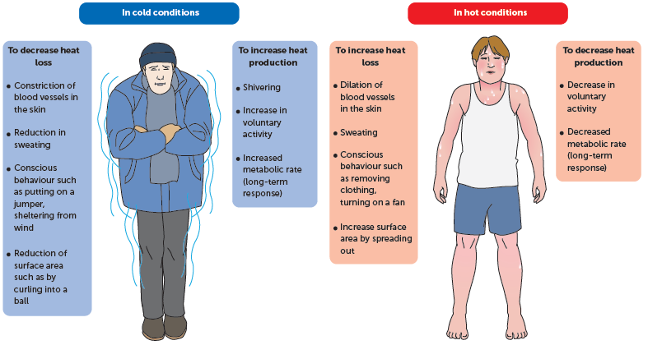
5.3 Thermoregulation
Mechanisms for regulating temperature

Slide 27
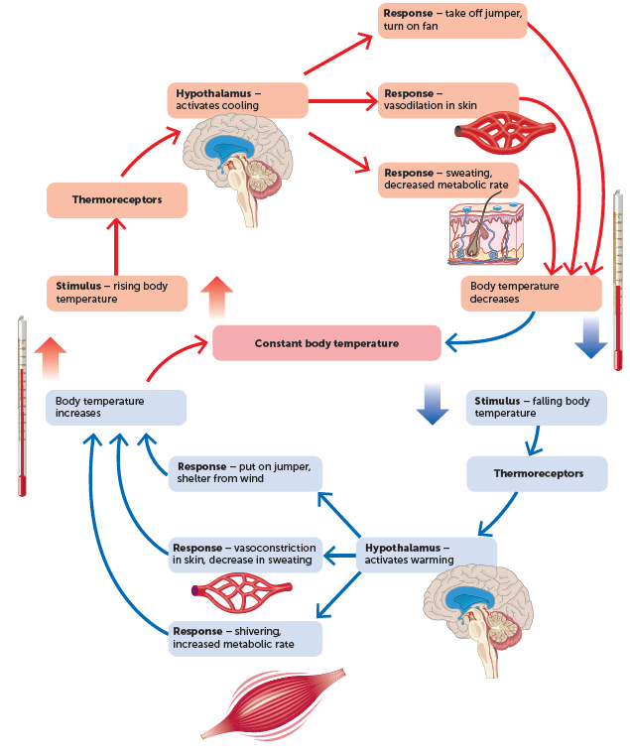
5.3 Thermoregulation
Control of thermoregulation
The hypothalamus exercises control over the various mechanisms involved in thermoregulation.

Slide 28
5.3 Thermoregulation
Temperature tolerance
A core body temperature over 42°C is dangerous and death usually occurs if it rises above about 45°C. High body temperature can result from a fever, but it can also occur in certain environmental conditions. When the temperature and relative humidity are high, it is difficult for the body to lose heat by radiation or evaporation. In this case, body temperature rises and the regulatory mechanisms cease, which is called heat stroke. Treatment consists of cooling the body as quickly as possible by immersing the patient in cold water.
Heat exhaustion occurs as a result of extreme sweating and vasodilation to lose heat. The loss of water in sweating reduces the volume of blood plasma and the vasodilation reduces resistance to blood flow. Blood pressure is thus reduced and output of blood from the heart decreases.
Extreme cold can also cause death. If a person’s core temperature falls below 33°C, the metabolic rate is so low that heat production is unable to replace the heat lost and body temperature continues to fall. This condition is called hypothermia.

